Slide 1
MDA - Final Exercises
Lorenz Linhardt (a1247418)
Raphael Mitsch (a1006529)
Magdalena Schwarzl (1209910)
Notes:
L

Slide 2
Regression
Notes:
L

Slide 3
Regression - Data
College (ISLR)
Dependent: Apps
Independent (17): Private (bool) Accept Enroll Top10perc Top25perc
F.Undergrad P.Undergrad Outstate Room.Board
Books Personal PhD Terminal S.F.Ratio perc.alumni
Expend Grad.Rate
Rows: 777
Condition: pristine
Notes:
L
meisen numerisch (1 catigoeriell)
some obviously connected (topXPerc)
no null & miss values, nice format
rows: nicht zu aufwändig

Slide 4
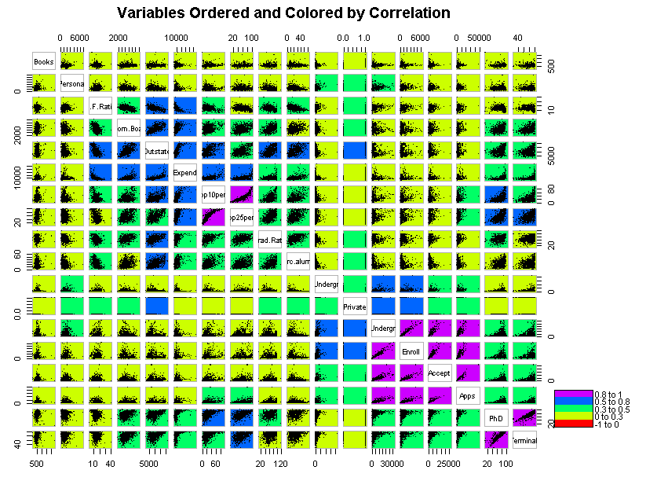
Notes:
L

Slide 5
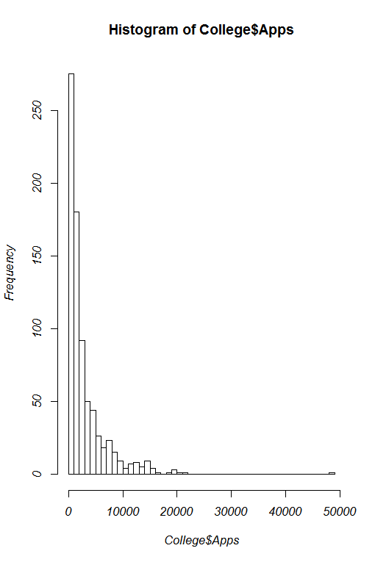
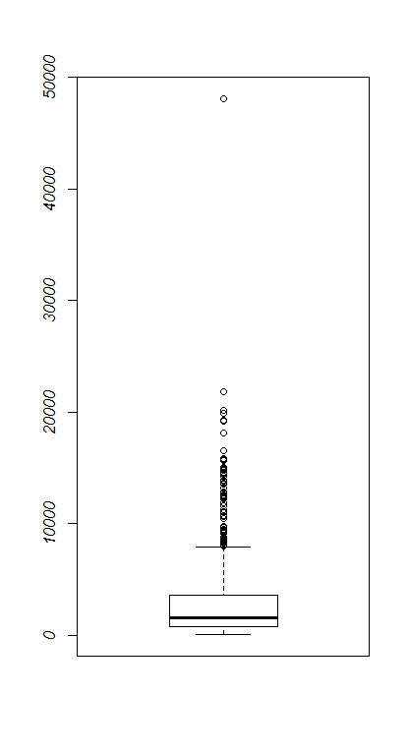
Target Variable: Apps
Min. 81
1st Qu. 776
Median 1558
Mean 3002
3rd Qu. 3624
Max. 48090
Notes:
L

Slide 6
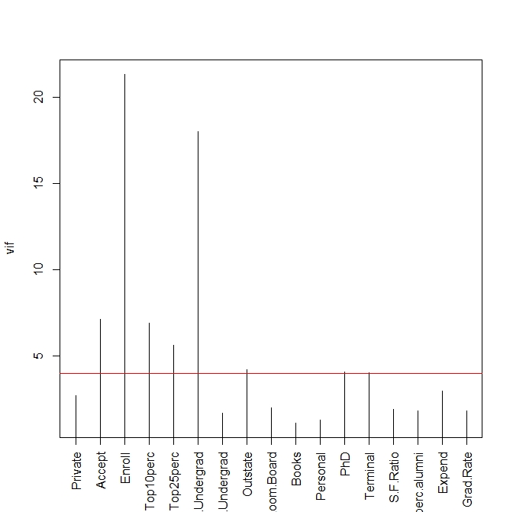
Regression - preprocessing
Remove outliers
Collinearity
remove columns with vif > 4
Split into training (75%) and test (25%) set
Split training set into 10 folds for cross validation
remove: Enroll, F.Undergrad, Top10perc, Outstate, PhD
Notes:
M
VIF = 1/ (1 - Ri ²) -> severity of multicollinearity
for each variable x compute Ri (linear regression using all other x as predictors)

Slide 7
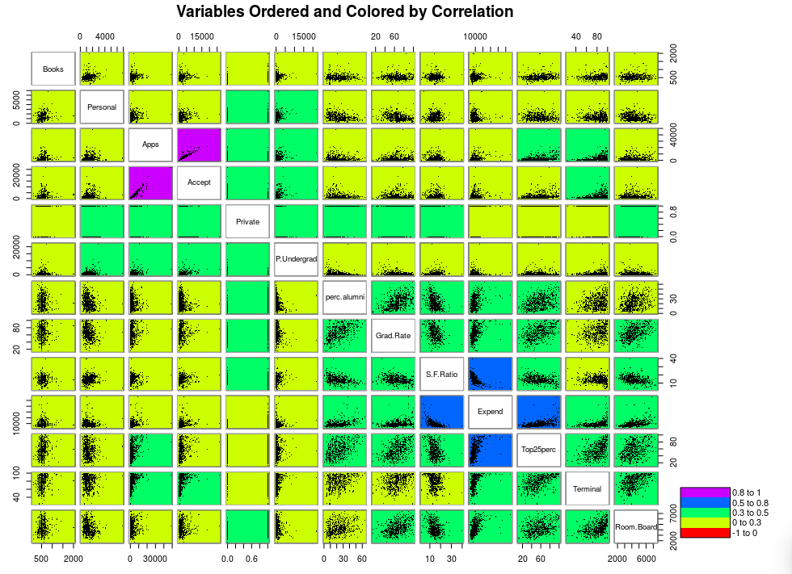
Notes:
M
strong corr between apps and accept - good

Slide 8
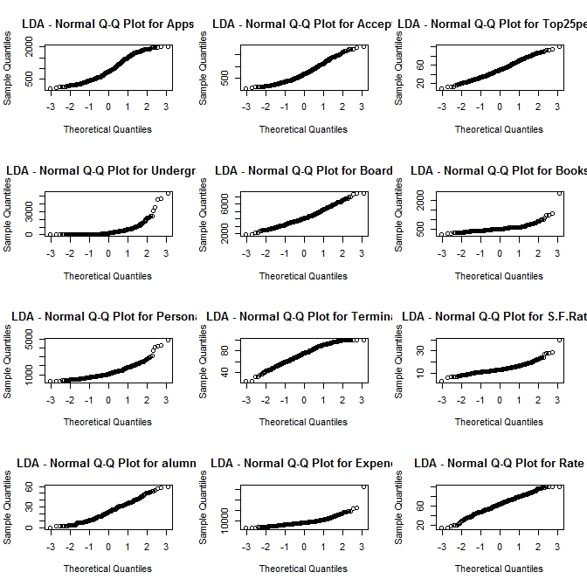
Regression - Model Assumptions
Independence of data → collinearity
Normality of errors (QQ-plots, Shapiro-Wilkinson)
Heteroskedasticity (Breusch-Pagan)
Differences in covariance matrices (in dependence of private)
Notes:
R
Unbiasedness, Independance, Normality of Errors
Homoscedasticity
check for colinearity remove columns with vif > 4
Independence
Normality of Errors

Slide 9
Evaluation Strategy
Training set (75%): Model selection, parameter tuning
Compare RMSE
Test set (25%): Evaluate best model, trained on training set
Training without outliers (except rob. regr.), test with outliers
Training Set Test Set
Notes:
R
train - via cross validation

Slide 10
Regression - Models
method | rmse (full dataset) | method | rmse
k-nn | 1110.486 | lts -fit | 1554.008 (1458.397)
cubic spline | 1176.283 | robust (Huber) | 1530.724 (1208.946)
linear regression | 1528.623 | robust (bisqu) | 1559.48 (1336.591)
loess | 1153.059 | log transform | 4798.845
regression tree | 3938.292 | box cox | 4710.03
Notes:
R
say/justify testing on outliers ...
check numbers - script put out some warning in the end
why are all the other so bad in comparison?

Slide 11
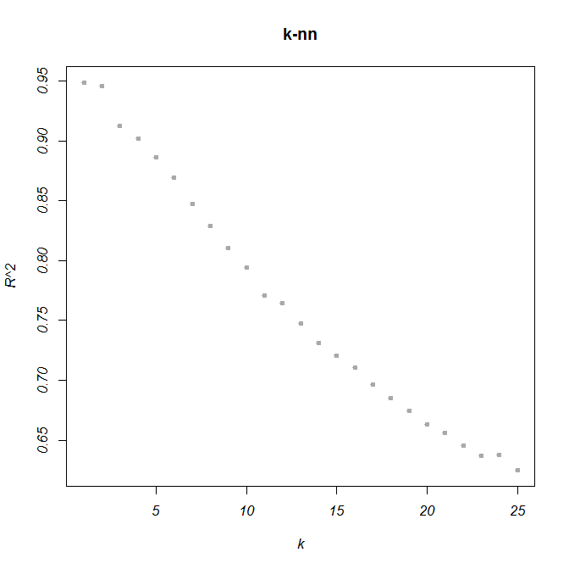
Regression - best model: k-nn
k = 1
library: FNN
Preprocessing: boolean to numeric {0,1}
Reduzierte Attribute
RMSE on training set: 1110.486 RMSE on test set: 746.334
Notes:
L
red attr, curese of dim (distance measures), sensitive to redundancy
lokale strukturen

Slide 12
Classification
Notes:
L

Slide 13
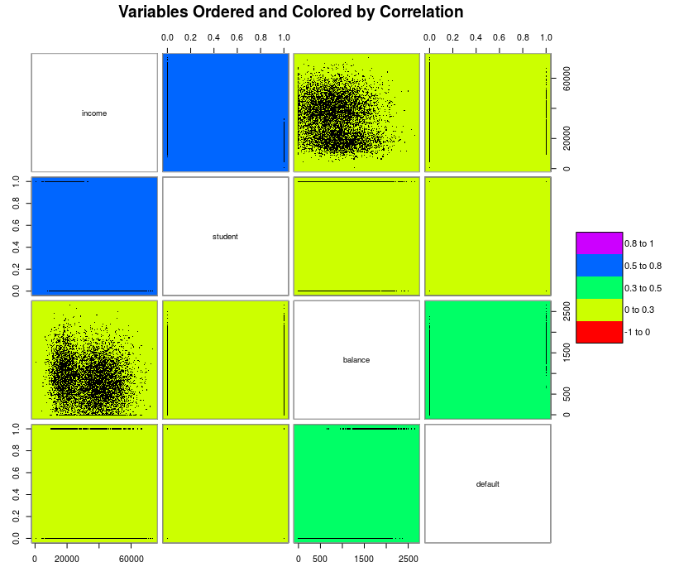
Classification - Data
default (ISLR)
Dependent: default (bool)
Independent (3): student (bool) balance income
Rows: 10.000
Class proportions: 9.667:333 ~ 29:1
Condition: pristine
Notes:
L

Slide 14
Classification - Preprocessing
Split into training (75%) and test (25%) set
Split training set into 10 folds for cross validation
Stratified folds - balanced classes
Notes:
R
Model assumptions for classification algorithms?

Slide 15
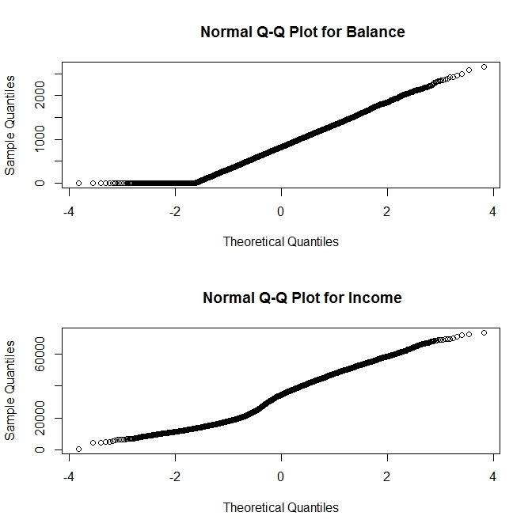
Classification - Model Assumptions
Independence of data → collinearity
Normality of data (QQ-plots, Shapiro-Wilkinson)
Heteroskedasticity (Breusch-Pagan)
Differences in covariance matrices
Indication of influence by student status
Notes:
R
Model assumptions for classification algorithms?

Slide 16
Evaluation Strategy
Training set (75%): Model selection, parameter tuning
Compare AUC, accuracy, balanced accuracy
Test set (25%): Evaluate best model, trained on training set
Training Set Test Set
Notes:
R
train - via cross validation

Slide 17
Classification - Models
method | AUC | Accuracy | Balanced
k-nn | 0.895 | 0.9512 | 0.6342
Naive Bayes | 0.944 | 0.9704 | 0.6404
Decision Tree | 0.777 | 0.9709 | 0.6634
LDA | 0.949 | 0.9744 | 0.6208
Logistic Regression | 0.949 | 0.9744 | 0.6456
QDA | 0.949 | 0.9727 | 0.6453
Random Forest | 0.902 | 0.9705 | 0.6253
Notes:
M accuracy: anteil der richtig klassifizierten an allen datensätzen
k -> inf: trend towards more frequent class (worse value for balanced accuracy)

Slide 18
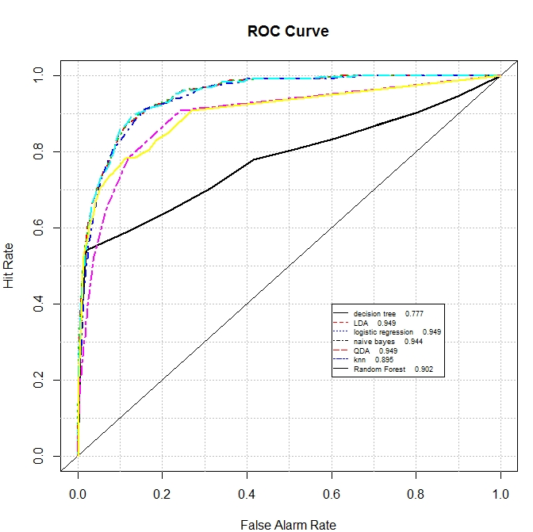
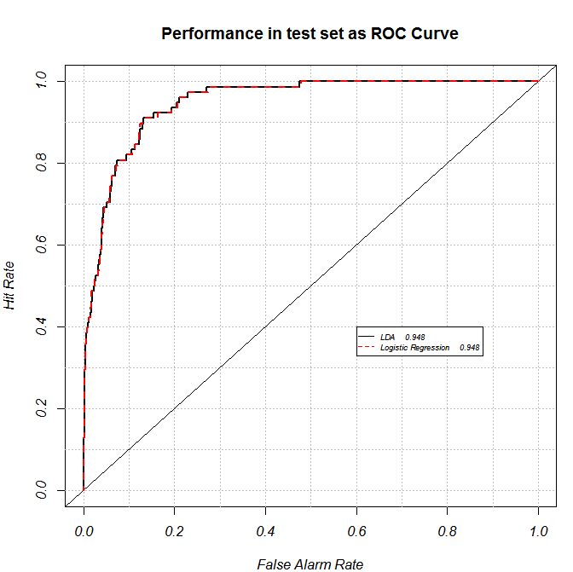
Classification - Evaluation
Notes:
M
links: test-set, rechts: test-set

Slide 19
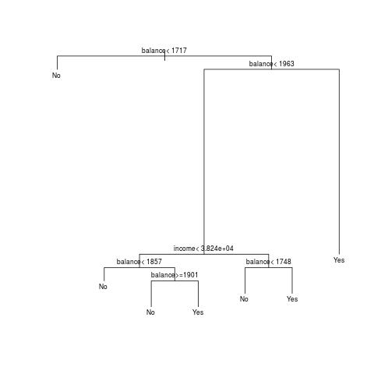
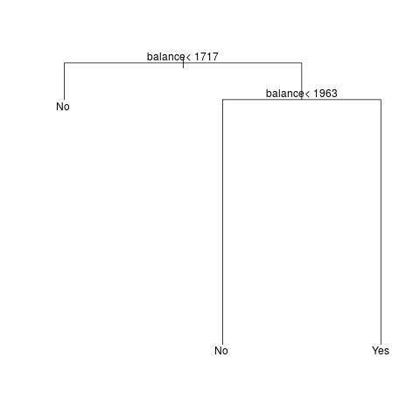
Classification - best model: Decision Tree
original post- pruned
Notes:
M
best model based on ROC

Slide 20
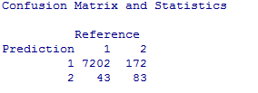
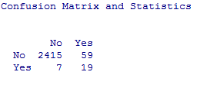
Classification - best model: Decision Tree
On training set (CV) On test set (trained on training set)
Notes:
M
best model based on ROC
zu verbessern:
roc with balanced accuracy
default-cutoff für confusion matrix?
normalize/scale regression data

